Slide 1
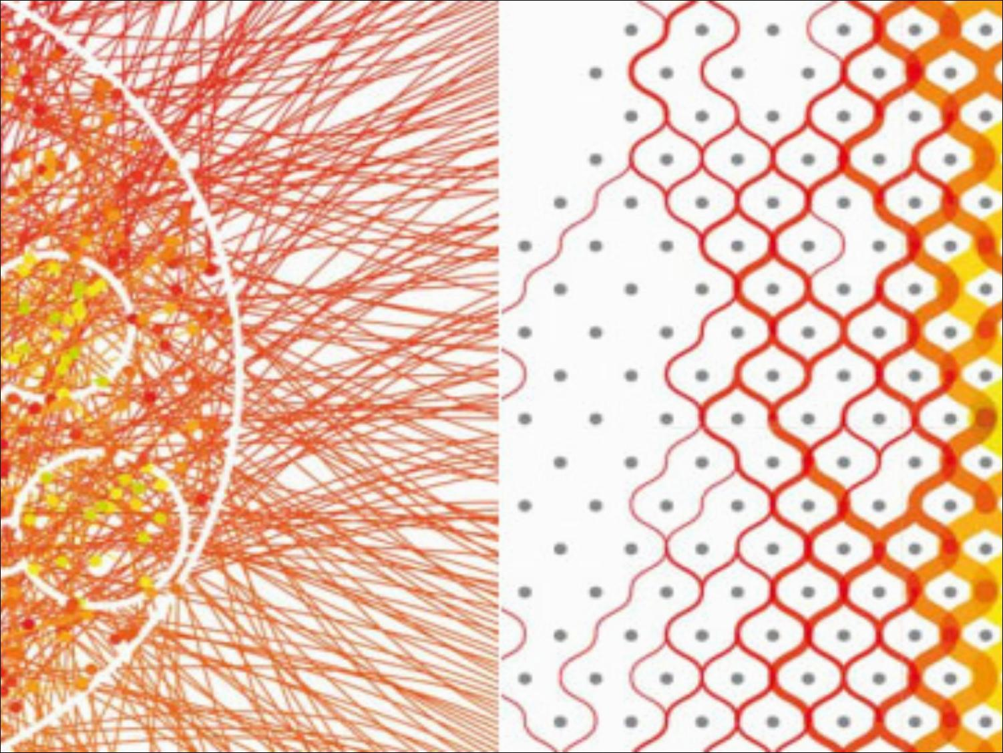
Stochastic Processes
Francesco Tamborra
Introduzione alle variabili aleatorie e ai sistemi complessi

Slide 2
Outline
Introduction & definitions
The Poisson process
The pure birth process
- the Yule process
The birth-and-death process

Slide 3
Introduction & definitions
A Markov chain is a discrete random process with the property that the next state depends only on the current state but not on the past history of the process or the manner in wich the present state was reached (“memorylessness”).
Examples of Markovian processes are random walks and branching processes.
In physics Markovian systems appear extensively in thermodynamics and statistical mechanics

Slide 4


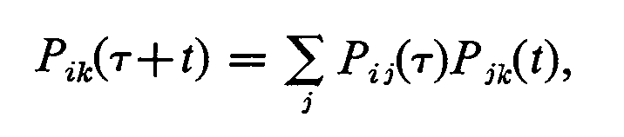
The terms “stochastic process” and “random process” are synonyms and are used to describe Markov chains when a time parameter is introduced as a countinuous variable.
Familiar examples modeled as stochastic processes include stock market and exchange rate fluctuations, signals such as speech, audio and video, medical data such as a patient's ECG, EEG, blood pressure or temperature or simply telephone calls.
In physics, some examples are given by radioactive disintegration and random movement such as Brownian motion or random walks.
stationary or time-homogeneous
Chapman-Kolmogorov identity

Slide 5
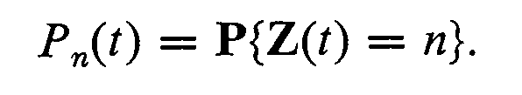


The Poisson process
The prototype for these processes. The Poisson distribution describes random events such as disintegrations of particles, incoming telephone calls and chromosome breakages under harmful irradiation.
notation
n jumps between 0 and t
h = 1/N
t
1
2
…
N
jump probability:
(1)
# of subintervals with a jump:
(2)

Slide 6



The physical picture of the process requires that a jump always leads from a state E_{j} to the neighboring state E_{j+1} :
(3)
(2)
(3)
We can now formulate the postulates for the Poisson process:
The process starts at epoch 0 from the state E₀.
Direct transitions from a state E_{j} are possible only to E_{j+1}.
Whatever the state E_{j} at epoch t, the probability of a jump whitin an ensuing short time interval between t and t+h equals λh + o(h), while the probability of more than one jump is o(h).

Slide 7

These conditions are weaker than the independance on the previous history but they suffice to show that these processes are well described by the Poisson distribution

Slide 8
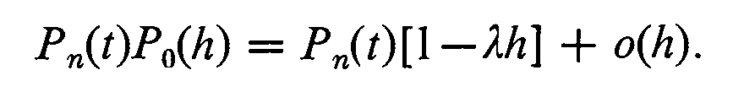

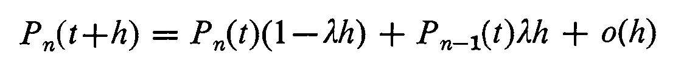
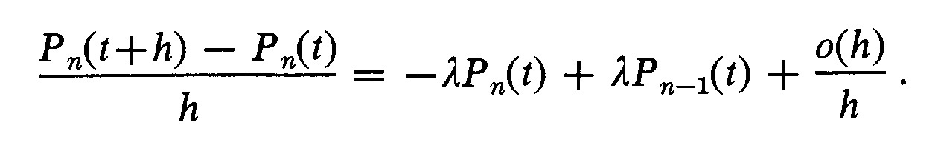
PROOF
Let us assume first n≥1 and consider the event that at epoch t+h the system is in state E_{n}. The probability of this event is P_{n}(t+h) and the event can occur in three mutually exclusive way:
1) At epoch t the system may be in state E_{n} and no jump occurs between t and t+h.
P_{n}(t+h) =
2) At epoch t the system is in state E_{n - 1} and exactly one jump occurs between t and t+h.
P_{n}(t+h) =
3) Any other state different from E_{n - 1} at epoch t requires more than one jump between t and t+h and the probability is o(h)
Considering all the contingiencies we have:
(4)
This equation can be rewritten in the form

Slide 9
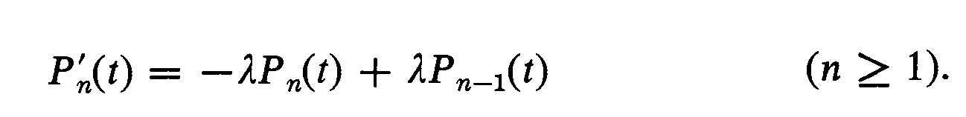
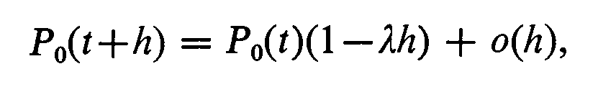
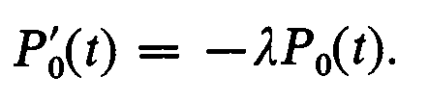
As h → 0, the limit on the left side exists and
For n = 0 the second and third contingencies do not arise and therefore Eq 4 must be replaced by
(5)
which leads to
From this and P₀(0)=1 we get P₀(t)= e^{-λt}
Substituting this P₀(t) into Eq 5 with n=1 we get an ordinary differential equation for P₁(t). Since P₁(0)=0 ,we find easily that P₁(t)= λt e^{-λt} .
Proceeding in the same way, we find successively all terms of the Poisson distribution.

Slide 10
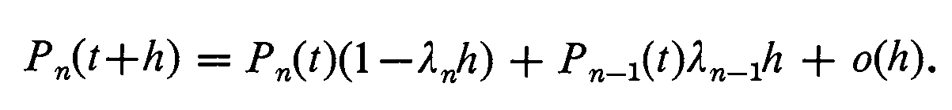
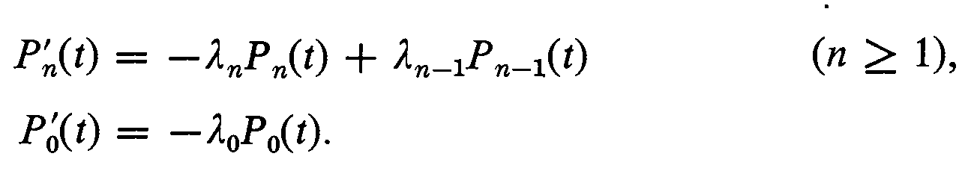
The pure birth process
The simplest generalization of the Poisson process is obtain by permitting the probabilities of jumps to depend on the actual state of the systems.
In this case the postulates are:
Direct transitions from a state E_{j} are possible only to E_{j+1}.
If at epoch t the system is in the state E_{n} the probability of a jump whitin an ensuing short time interval between t and t+h equals λ_{n}h + o(h), while the probability of more than one jump is o(h).
With the same reasoning adopted in the previous section we can derive the probability P_{n}(t+h) (cfr. with Eq. 4)
In this way we get the basic system of differential equations:
(6)

Slide 11
We may now assume more generally that the system starts from an arbitrary initial state E_{i} . This implies that
These initial conditions uniquely determine the solution {P_{n}(t)} of the system of differential equations.

Slide 12



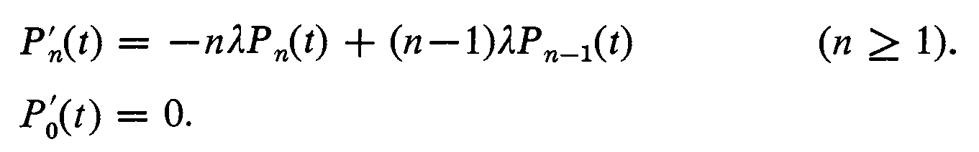
The Yule process
Let us consider a population of members which can give birth to other members (by splitting for example) but cannot die.
λ
rate of increase of the population
satisfy the system (6) with

Slide 13
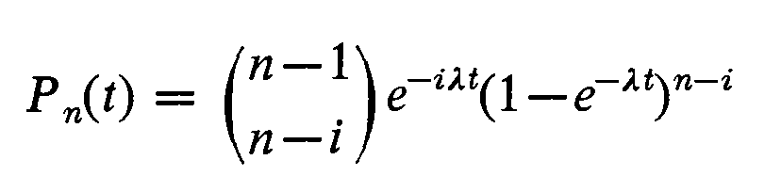

Denoting the initial population size by i, the initial conditions are
and for n ≥ i > 0 we get
and, of course, for n < i

Slide 14
The birth-and-death process
The B&D model generalizes the pure birth model by permitting transition from the state E_{n} not only on the higher state E_{n+1} but also to the next lower state E_{n-1}.
Postulates:
The system changes only through transitions from states to their nearest neighbors (from E_{n} to E_{n+1} or E_{n-1} if n ≥ 1, but from E₀ to E₁ only).
If at epoch t the system is in state E_{n} ,the probability that between t and t+h the transition E_{n} → E_{n+1} occurrs equals λ_{n}h + o(h),and the probability of E_{n} → E_{n-1} (if n ≥ 1) equals μ_{n}h + o(h).
As usual the probability of more than one change during the interval is o(h).

Slide 15
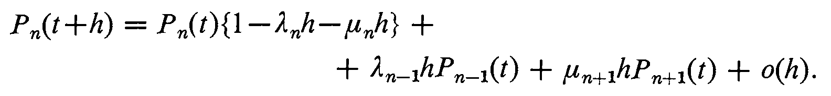
Now, the state E_{n} at epoch t+h is possible only under one of the following conditions (mutually exclusive):
at epoch t the system is in E_{n} and between t and t +h no change occurs;
at epoch t the system is in E_{n-1} and a transition to E_{n} occurs;
at epoch t the system is in E_{n+1} and a transition to E_{n} occurs;
between t and t+h there occur two or more transitions; by assumption, this probability is o(h).
Therefore the probability is

Slide 16
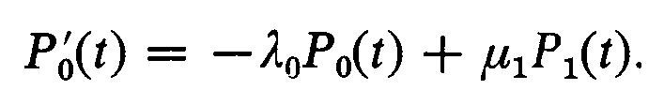
With some algebra and performing the same limit h → 0 as before we get the system
(n ≥ 1)
(n = 0)
With the usual initial conditions for the initial state E_{i}
The birth-and-death process is thus seen to depend on an infinite system
of differential equations together with the initial conditions.
The question of existence and of uniqueness of solutions is in this case by
no means trivial.

Slide 17
It can be shown (either from the explicit form of the solutions or from
the general ergodic theorems for Markov processes) that under any
circumstance the problem can be treat as a Markov chain.
Using this technique it is possible to see that the fate of the population depends on the λ/μ ratio.
If λ/μ is lower than a certain critical value the population goes toward the ultimate extinction; in fact when λ₀ = 0 the transition E₀ → E₁ is impossible. In the terminology of Markov chains E₀ is an absorbing state from which no exit is possible.
If λ/μ is larger than a certain critical value the population increases over all bounds;
Otherwise the population can either die out or increase indefinitely.
Thank you

